Slide 2
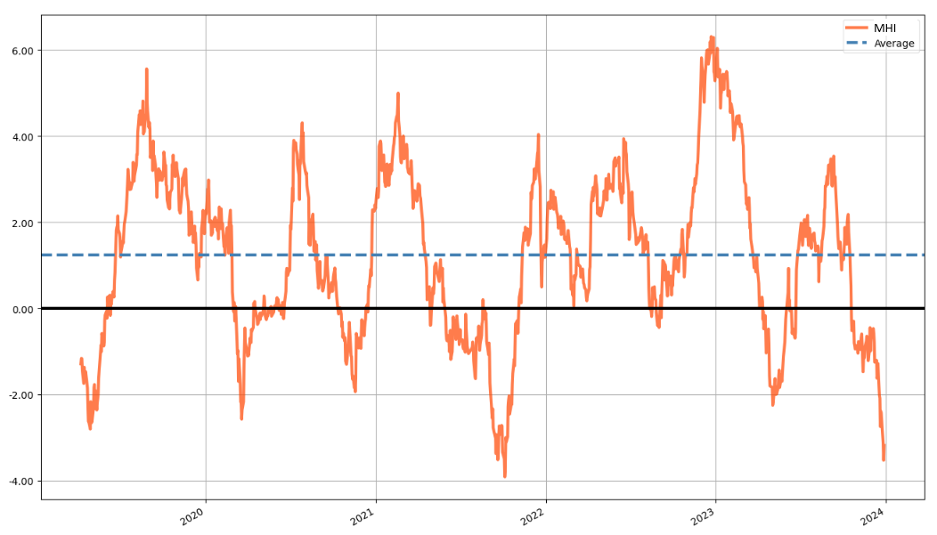
Market Health Index (MHI) - A mean-reverting index for trend detection
(Last 1835 days)

Slide 3
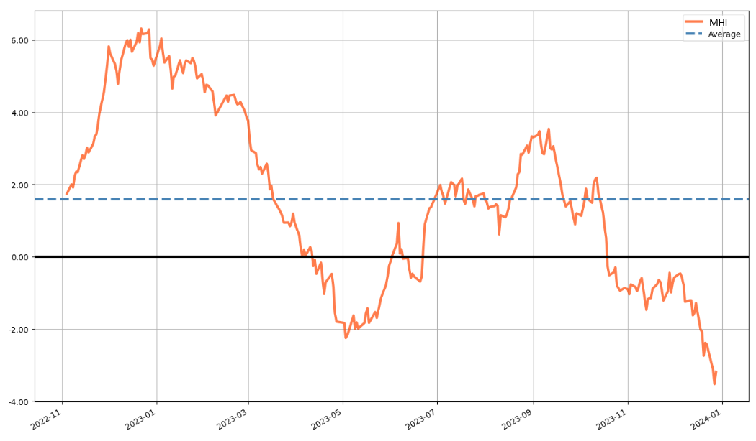
Market Health Index (Last 365 days)

Slide 4
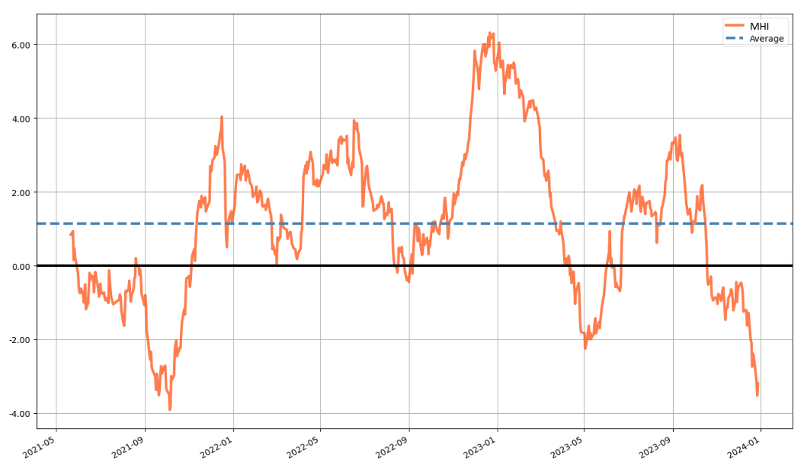
Market Health Index (Last 730 days)

Slide 5
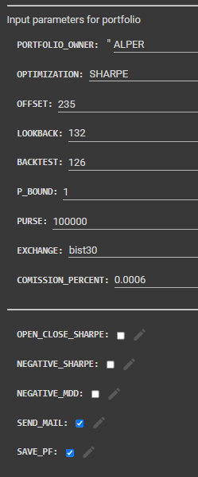
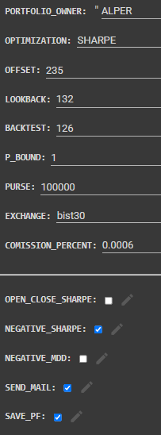
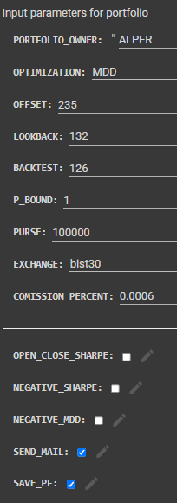
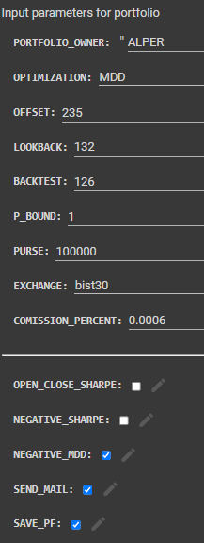
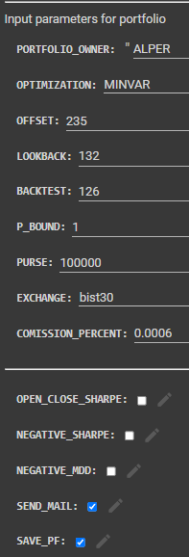

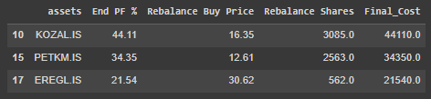
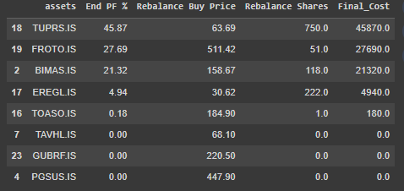

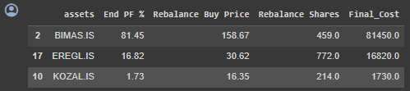
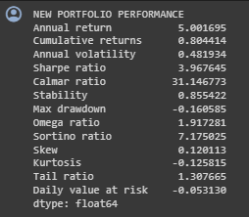
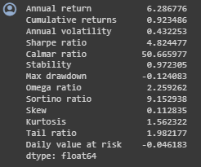
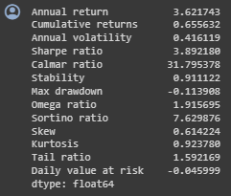
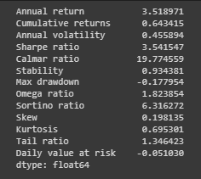
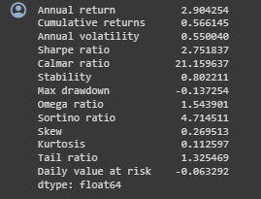
Sharpe, Inverse Sharpe, MDD, Inverse MDD and MINVAR Portfolios
Return: %56.6
SR: 2.75
MDD: %13.7
Return: %80.4
SR: 3.96
MDD: %16.1
Return: %92.3
SR: 4.82
MDD: %12.4
Return: %65.6
SR: 3.39
MDD: %11.4
Return: %64.3
SR: 3.96
MDD: %17.8

